Slide 1
Telehealth Lessons Learned and Best Practices
Shannon C. Scott, DO, FACOFP
Medical Director, Midwestern University Multispecialty Clinic, Glendale, AZ
Clinical Professor and Assistant Dean, Arizona College of Osteopathic Medicine
Board Certified, ABOFP and ABFM
Health Policy Fellow, American Osteopathic Association

Slide 2
Arizona Public Health Emergency ~95,000 Cases ~1800 Deaths ~ 2500-3000 daily cases over the last 2 weeks ~ 10% total percent positive

Slide 3
Presentation Goals
Describe key telehealth changes during COVID pandemic.
Share our story of the rapid transition to telehealth.
What went well?
What are lessons we are learning?
Determine best practices for conducting the telehealth visit?
What do the experts say?
What do our patients say?
Describe billing and coding strategies published by Medicare.
Define Medicare Telehealth visits.
Discuss the next steps in telehealth.
These topics are meant to be a general summary and not intended to take the place of either written law, regulations, or reimbursement. Please review specific state statutes and regulations for full and accurate content.

Slide 4
MWU Multispecialty Clinic Glendale AZ
Patient care numbers prior to COVID
Daily patient appointment volume~ 200
Daily patient phone call volume ~200
Family Medicine monthly appointment volume ~1200
Family Medicine Clinic
13 Providers (DO, PAs)
Foot and Ankle Clinic
2 Providers (DPM)
Osteopathic Manipulative Medicine Specialty Clinic
5 Providers
Pharmacy Services
4 Providers (PharmD)
Support staff
30+ (Nurses, MA, patient account representatives, billing, etc.)

Slide 5
Telehealth Quick Implementation
Determine the need
What are you trying to accomplish?
What services are appropriate for telehealth?
Determine the technology
Recommended to take a long look at what works the best
Pre-test on patients
National Telehealth Technology Assessment Resource Center (TTAC)
Legal and Regulatory Considerations
Informed consent
Southwest Telehealth Resource Center
Licensure
Federation of State Medical Boards, States Waiving Telehealth Licensure
Medical Malpractice
HIPAA
Center for Connected Health Policy- The National Telehealth Policy Resource Center
Workflow
Training: health care team, support staff, AND patients.
Reimbursement
The MLN Booklet Telehealth Services (Center for Medicare Services)
Feedback and Fine tuning
Notes:
Technology: HIPAA compliance, Product Types, Wireless support, Train patients, get them comfortable, Have a back up plan
How do I find the right telehealth vendor for my practice?
You have a number of options for telehealth delivery. The first step is to identify any technology that you already have access to. For example, your patient portal may have some types of telehealth functionality built in.
Once you’ve identified what you already have, here are some questions to assist in researching additional options:
How does the vendor protect personal health information?
Is a contract required?
Does it require any special equipment?
Is there a waiting room feature?
Can staff or patients schedule visits through the platform?
Can patients provide consent to receive telehealth on the platform itself?
Will your patients need to download an application to have a telehealth visit?
The federal Office of Civil right (OCR) has temporarily relaxed its standards during this national emergency to allow covered health care providers to use video technologies that do not fully comply with HIPAA rules. More information in the following slides.
Legal: Informed consent, Licensure, Medical Malpractice, HIPAA
Workflow: How to schedule patients, what do we say on the phone, how to start the visit, what to do during the visit, how to conclude the visit, what do you document
Reimbursement: this is complex and not necessarily consistent across payors. I will break down Medicare in the slides that follow. Medicaid- we only take one plan in our clinic and had to reach out directly. Private payors- reach out to each individually. Most states have passed telehealth parity legislation to mandate that payers cover a telehealth for services that were previously delivered in person. Payment parity (getting reimbursed the same as in-person care) may vary among private payers. Billing and coding for telehealth will be discussed in slides that follow.

Slide 6
Implementation of Telehealth in MSC
Decrease In-office Visits to 25%
Increase Telehealth to 60%
AZ Stay at Home Order
Telehealth Switch to 80%
In-Office Visits to 20%
~2 weeks
Increase In-Office Visits to 40%
Decrease Telehealth to 50%
Arizona COVID Cases Epi Curve from AZ Dept Public Health
Notes:
researching HIPAA compliance, billing and coding, documentation requirements, internet connections, provider and staff equipment needs.
Customer service and synchronous appointment etiquette
Call volume never changed:
Rapid Transition to Telehealth via WebEX in 2 weeks!
Mixed in-person and telehealth schedules.
Front desk scheduling appointments and onboarding of patients to platform.
Providers using telehealth as “triage”.
All patients to Telehealth unless determined by provider.
Clinical staff trained 2 weeks after the transition.
Retraction of blended schedule for providers.
Clinical staff “rooming patient” procedure for appointments.
Frequent workflow changes for scheduling department.
COVID-19 staff reduction by administration during implementation of work from home.

Slide 7
Let’s back up for some definitions…..
Telehealth
A broad scope of remote health care services!
Any remote clinical or non-clinical service between a provider and a patient/client.
Direct patient care (synchronous or asynchronous)
Clinician to clinician consults
Patient education services
Interprofessional care team communications
Many more…
Telemedicine
The practice of medicine using technology to deliver care at a distance.
A physician/clinician in one location uses a telecommunications infrastructure to deliver care to a patient at a distant site.
Remote Patient Monitoring
Technology devices to gather patient data:
*Digital scales
*Glucometers
*Pulse ox devices, etc..
mHealth
‘Mobile health’, encompasses healthcare using mobile networks and devices…cell phone technology and software systems. Regulatory issues have not been clearly resolved, deployment and usage scenarios are still being worked out in many organizations, and there are a host of concerns around the privacy, security, and reliability of mobile healthcare devices.
Notes:
Synchronous: This includes real-time telephone or live audio-video interaction typically with a patient using a smartphone, tablet, or computer.
In some cases, peripheral medical equipment (e.g., digital stethoscopes, otoscopes, ultrasounds) can be used by another HCP (e.g., nurse, medical assistant) physically with the patient, while the consulting medical provider conducts a remote evaluation.
Asynchronous: This includes “store and forward” technology where messages, images, or data are collected at one point in time and interpreted or responded to later. Patient portals can facilitate this type of communication between provider and patient through secure messaging.
Remote patient monitoring: This allows direct transmission of a patient’s clinical measurements from a distance (may or may not be in real time) to their healthcare provider.

Slide 8
Telehealth- CDC Determinants
BENEFITS of Telehealth:
Facilitate social distancing, reduces potential infectious exposures, and reduces PPE use by HCP.
Maintains continuity of care to avoid delayed preventive, chronic, or routine care.
USES of Telehealth:
Screening patients who may have symptoms of COVID-19 and refer as appropriate.
Provide low-risk urgent care for non-COVID-19 conditions.
Identify patients who may need additional medical consultation or assessment.
Access primary care providers and specialists, including mental and behavioral health, for chronic health conditions and medication management.
Participate in physical therapy, occupational therapy, and other care team members.
Engage in case management for patients who have difficulty accessing care.
Follow up with patients after hospitalization
Deliver advance care planning and counseling to patients and caregivers.
Provide non-emergent care to residents in long-term care facilities.
POSSIBLE LIMITATIONS
Interstate licensure challenges and other regulatory issues that may vary by state.
Some in-person visits are more appropriate due to urgency, or underlying conditions.
Addressing sensitive topics, especially if there is patient discomfort or concern for privacy.
Limited access to devices (e.g., smartphone, tablet, computer) needed for a telehealth visit.
Level of comfort with technology for HCP and patients.
Cultural acceptance of conducting virtual visits in lieu of in-person visits by HCP and patients.

Slide 9
The U.S. Department of Health and Human Services Office for Civil Rights issued a Notification of Enforcement Discretion.
HIPAA flexibility during the COVID-19 Public Health Emergency “empowers covered HCP to use widely available communications applications without the risk of penalties imposed by the U.S. Department of Health and Human Services Office for Civil Rights for violations of Health Insurance Portability and Accountability Act of 1996 (HIPPA) rules for the good faith provision of telehealth services”.
Ok to use popular “non-public facing” applications to deliver telehealth.
Video: Apple FaceTime, Facebook Messenger video chat, Google Hangouts video, Zoom, Skype
Text-based: Signal, Jabber, Facebook Messenger, Google Hangouts, WhatsApp, iMessage
For HCP seeking additional privacy protections, use technology vendors that are HIPAA compliant and will enter into HIPAA business associate agreements in connection with the provision of their video communication products.
Likely have agreements: Skype for Business / Microsoft Teams, Updox, Vsee, Zoom for Healthcare, Doxy.me, Google G Suite Hangouts Meet, Cisco Webex Meetings / Webex Teams, Amazon Chime, GoToMeeting, Spruce Health Care Messenger
Do not provide telehealth on any platforms that are “public-facing”
Examples are Facebook Live, Twitch, and TikTok.
Disclaimer: The U.S. Department of Health and Human Services Office for Civil Rights has not reviewed the business associate agreements offered by these vendors, and this list does not constitute an endorsement, certification, or recommendation of specific technology, software, applications, or products. The reference to named video- and text-based communications software for telehealth is informational and not intended as an endorsement of those services.
https://www.hhs.gov/hipaa/for-professionals/special-topics/emergency-preparedness/notification-enforcement-discretion-telehealth/index.html

Slide 10
Preparing Patients for Telehealth
Announce the Availability of Telehealth
Once you’re ready to let your patients know about telehealth
Send an email to patients
Mailing a letter or postcard
Prioritize Patient Communication
Telehealth basics: What is Telehealth?
Explain Benefits of Telehealth
Safety — reduces everyone’s exposure during COVID-19
Convenience
Time-saving — no need to commute
Explain Scheduling Process
How patients can schedule a telehealth appointment
Communicate Visit Expectations
How patients will connect with you through a video conferencing tool
What patients will need in order to use the system
What to do if they need help troubleshooting
What to wear to an appointment — like loose clothing if needed
Any pre-appointment instructions — like taking their temperature, take blood pressure, have medications ready for review.
How patient personal information is protected
What types of care will be offered through telehealth
Where to find electronic Notice of Privacy Practices
How the visit may be different from an in-person visit
COVID screening process
Update Your Website
For example, if they need to download an application, or log into patient portal.
Notes:
The transition to telehealth platforms is an adjustment for patients as well as health care providers. By preparing your patients for this new experience, you help ensure their comfort and maintain quality care.
Patients are likely to have a lot of questions about what to expect from a telehealth visit. Here are some key things you can cover to help them feel at ease.
Prior to seeing patients via telehealth, think through the process.
Who is responsible for scheduling and sending a link to the patient?
Will the patient connect directly with the health care provider or will an MA or front office staff greet the patient first?
There is no right or wrong way to do this, but it is good to have a plan.

Slide 11
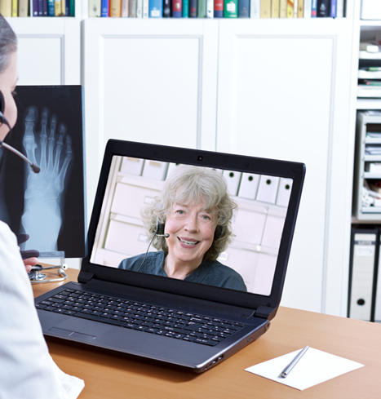
Workflow
Before the visit
What information is needed and how will that information be obtained?
Who will enter information in the electronic health record?
Start of the visit
Introduce yourself and show some identification, i.e. work badge so the patient knows who you are.
Verify the patient’s identity.
Check to see that both ends of the line can see and/or hear each other.
Let the patient know that it is okay to interrupt if they can’t hear you.
Consent the patient (and document)
Communicate a back-up plan in the event the technology fails, just in case.
During the visit
See tips from the “Pros”
End of the visit
Ask the patient if they have questions.
Be clear what the next steps are for both patient and provider.
Document!!!!!!!!
Patient’s location
Provider’s location
That the encounter was conducted via telehealth
Start and stop time
That the patient consented (unless otherwise documented)
Any other providers involved, including presenter
A reason for using telehealth (medical or otherwise)
Key physical exam components you were able to perform.
Follow up plan
Notes:
THINK through the visit process start to finish- PRACTICE A FEW TIMES!!
Have a co-worker role play as the patient, then walk through a full visit.
Continuously evaluate and adjust the workflow as needed

Slide 12
Informed Consent?
Medicare does not require that an informed consent prior to a telehealth-delivered service.
Most states either require informed consent be obtained within their Medicaid program or in their statute or rules regulating healthcare professionals.
Telehealth informed consent, often requires a written form and/or oral acknowledgement that is noted in the patient’s record.
Explains what telehealth is, including expected benefits and possible risks.
Explains security measures.
In many cases, each state has varying informed consent requirements depending on a given profession.
Check with your state.
Notes:
Our practice does a verbal consent that includes: Patient initiated telehealth services and offered consent for telehealth in lieu of in-person office visit. Verbal acknowledgement that the telehealth visit will be sent to health care insurance carrier.
Sometimes laws are written in such a way that can be interpreted to mean a healthcare professional must obtain informed consent each time telehealth is used, while other laws only require informed consent for the first telehealth visit in a series of visits for the same condition.

Slide 13
Conducting the Visit- Tips from the Pros
Test your equipment prior to your patient visits.
Log in to the platform you will be using, on the device you will be using, prior to seeing patients. (make sure everything is downloaded and operational prior to your test visit).
Pro tip- create a shortcut on your desktop for all applications you will have to run for your Telehealth visit.
• For HIPAA- make sure you are in an area where others cannot see your screen.
Test the lighting while on a test call to make sure your patient can see you clearly.
Do not have a window behind you.
If possible, have a solid background behind you (blue or gray is preferred).
Pro tip- a lamp in front of you (to the side of your computer) helps show your facial features better to the patient
Eliminate clutter around the view of the camera to prevent it from trying to focus throughout the call. This is very distracting for the patient.
Pro tip- You might want to reduce or eliminate the number of personal items visible to the patient. You want them focused on you and not what’s in your office or living room.
Pro-tip- Wear solid colors as they are better on camera and prevent it from trying to focus on patterns.
Courtesy of
Notes:
I like the split screen or 2 computer monitor system

Slide 14
Tips from the Pros Cont.
Test the audio with someone on a test call.
Many mics are not omni directional so be careful to stay directly in front of your computer/ mic and not talk while your head is turned away.
For HIPAA- Make sure you are in an area that others cannot hear your conversations online.
Try to eliminate other noises around you as it can make it difficult for the patient to understand you.
Pro-tip- you will find rooms that have a lot of hard surfaces to be “echo-ie”.
Rooms with carpet or softer finishes have better sound on the calls.
Keep your home screen clear from personal information in the event you are screen sharing.
Pro-tip- never have anything on your screen that you wouldn’t want others to see.
Pro-tip- make sure you are completely presentable head to toe in the event there is ever a slippage with the camera.
You won’t be able to just stick your head out of a room to find someone.
Have a prearranged plan for how your will reach team members before, during, and after a patient visit that is HIPAA compliant (suggest tasking).
Courtesy of
Notes:
Wear pants
Share screen with patients
Messaging system

Slide 15
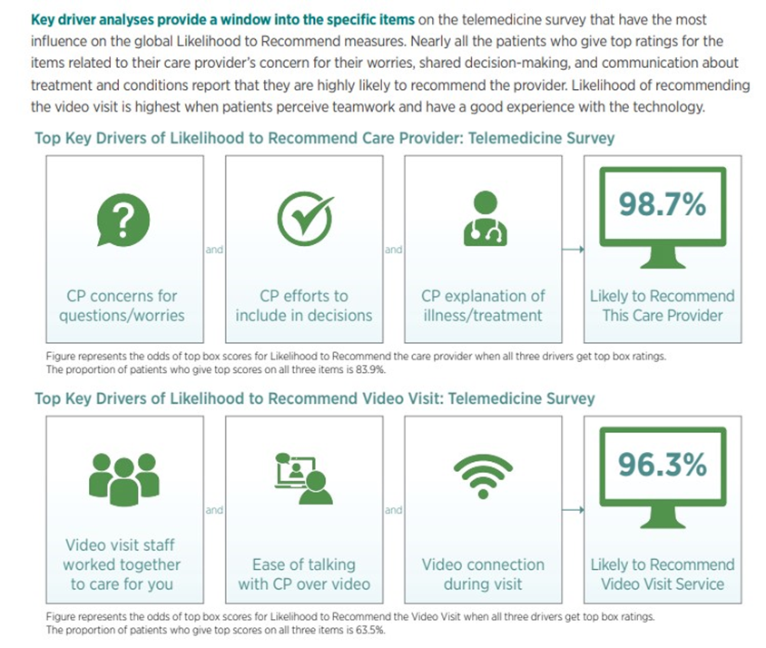
Landmark Customer Service Survey- Telehealth
Over a six-week period, Press Ganey has administered more than 3.5 million telemedicine surveys.
By the end of April, nearly 70% of returned medical practice surveys reflected full or mixed telemedicine visits.
Analyses of more than 30,000 early consumer responses to telemedicine surveys received through the end of April paint a favorable picture for patient experience with virtual visits.
Notes:
where “mixed” refers to encounters that may be entirely video-based or a combination of video and in-person, telephone, email, or text, but not documented.
These data paint a powerful picture of how rapidly health systems have transitioned to new delivery models for nonemergent medical practice visits and the survey results provide important insights for meeting patient needs as care models evolve.
Based on the data, patients are overwhelmingly positive about their virtual interactions with their care providers, even when technical issues posed challenges, as indicated by the lower scores for technology-related items.

Slide 16
Optimizing the Telemedicine Patient Experience
Patients experiencing telemedicine gave high ratings to their care providers, suggesting the efficacy of this model for nonurgent medical visits.
To make these visits optimally successful, providers should focus on
Four key communication skills:
Authenticity: Be genuine. Be more conscious of the warmth of opening and closing greetings. Confirm that the patient can hear and see you clearly. Avoid interruptions.
Agenda setting: Identify and confirm the patient’s priorities at the outset and communicate how these priorities will be addressed.
Empathy: Consistently convey empathy through language. Check in deliberately about patients’ worries or concerns throughout the visit and especially at the close.
Closing checklists: Bring structure to officially closing out the session so that patients know what to expect. Summarize the post-visit plan, reinforcing patient and provider actions. Review questions and answers. Offer instructions for follow-up concerns.
Notes:
See the whole family at once, send in other consultant.

Slide 17
Medicare Specific Visits 1. Telehealth 2. Virtual Check-ins 3. E-visits 4. Telephone It is imperative during this public health emergency that patients avoid travel, when possible, to physicians’ offices, clinics, hospitals, or other health care facilities where they could risk their own or others’ exposure to further illness. Accordingly, the Department of Health and Human Services (HHS) is announcing a policy of enforcement discretion for Medicare telehealth services furnished pursuant to the waiver under section 1135(b)(8) of the Act. To the extent the waiver (section 1135(g)(3)) requires that the patient have a prior established relationship with a practitioner, HHS will not conduct audits to ensure that such a prior relationship existed for claims submitted during this public health emergency.
TELEHEALTH VISITS
Currently, Medicare patients may use telecommunication technology for office, hospital visits and other services that generally occur in-person.
The provider must use an interactive audio and video telecommunications system that permits real-time communication between the distant site and the patient at home.
Allowable for new and established patients.
Distant site practitioners who can furnish and get payment for covered telehealth services (subject to state law) can include physicians, nurse practitioners, physician assistants, nurse midwives, certified nurse anesthetists, clinical psychologists, clinical social workers, registered dietitians, and nutrition professionals.
Payment parity for in-person office visits.
Notes:
This is not a telephone call visit. KEY TAKEAWAYS:
Effective for services starting March 6, 2020 and for the duration of the COVID-19 Public Health Emergency, Medicare will make payment for Medicare telehealth services furnished to patients in broader circumstances.
These visits are considered the same as in-person visits and are paid at the same rate as regular, in-person visits.
While they must generally travel to or be located in certain types of originating sites such as a physician’s office, skilled nursing facility or hospital for the visit, effective for services starting March 6, 2020 and for the duration of the COVID-19 Public Health Emergency, Medicare will make payment for Medicare telehealth services furnished to beneficiaries in any healthcare facility and in their home.

Slide 18
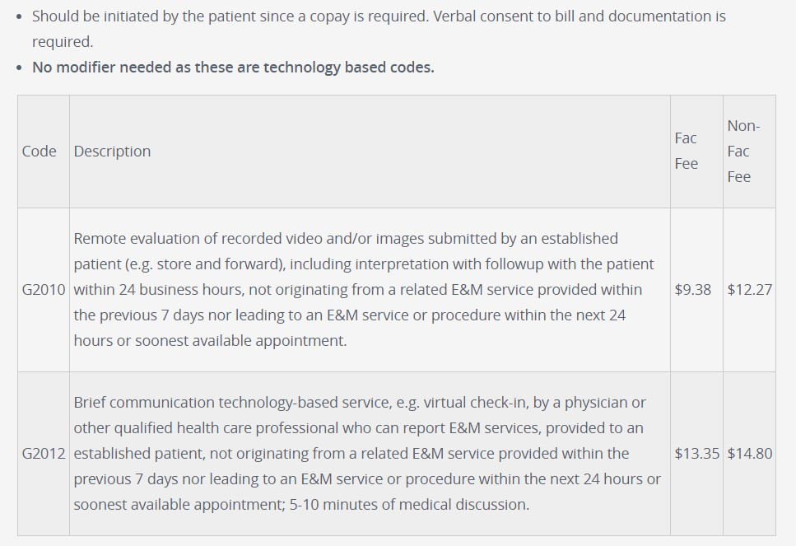
Medicare Virtual Check- Ins (Brief)
Are brief communication services with practitioners via several communication technology modalities including:
Synchronous discussion over a telephone; 5-10 minutes of medical discussion.
HCPCS code G2012
Exchange of information through video or image (for interpretation).
HCPS code G2010
For both new patients or patients with an established relationship.
Communication can not be related to a medical visit within the previous 7 days and can not lead to a medical visit within the next 24 hours (or soonest appointment available).
The patient must verbally consent to receive virtual check-in services.
The practitioner may respond to the patient’s concern by telephone, audio/video, secure text messaging, email, or use of a patient portal.
Notes:
Virtual check-ins can be conducted with a broader range of communication methods, unlike Medicare telehealth visits, which require audio and visual capabilities for real-time communication.

Slide 19
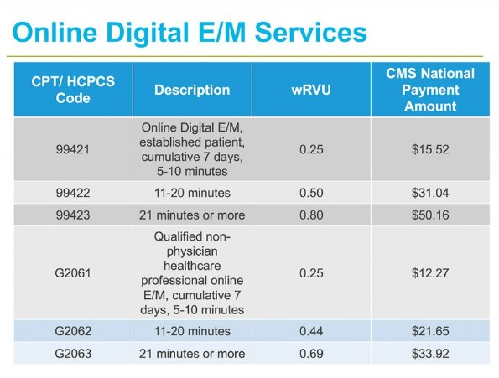
Medicare E- Visits
A non-face-to-face patient-initiated communications with their doctors without going to the doctor’s office by using online patient portals.
For only established relationship.
The patient must verbally consent to receive virtual check-in services.
The patient must generate the initial inquiry and communications can occur over a 7-day period.
https://www.hccinstitute.org/hccintelligence-update-covid-19-telehealth-billing-requirements/
Notes:
KEY TAKEAWAYS:
These services can only be reported when the billing practice has an established relationship with the patient.
This is not limited to only rural settings. There are no geographic or location restrictions for these visits.
Patients communicate with their doctors without going to the doctor’s office by using online patient portals.
Individual services need to be initiated by the patient; however, practitioners may educate beneficiaries on the availability of the service prior to patient initiation.
The services may be billed using CPT codes 99421-99423 and HCPCS codes G2061-G206, as applicable.
The Medicare coinsurance and deductible would generally apply to these services.

Slide 20
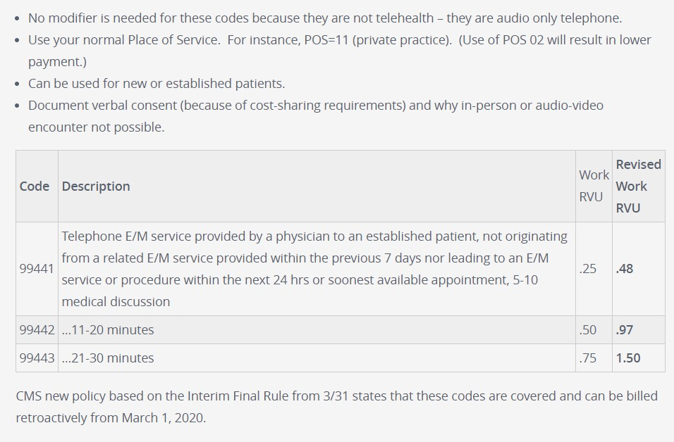
Medicare Telephone (Audio-only) Visits
Telephone Evaluation, Management/Assessment and Management Services, and Behavioral Health and Education Services.
A broad range of clinicians, including physicians, can now provide certain services by telephone to their patients.
Medicare payment for the telephone evaluation and management visits (CPT codes 99441-99443) is equivalent to the Medicare payment for office/outpatient visits with established patients effective March 1, 2020.
https://www.acponline.org/practice-resources/covid-19-practice-management-resources/telehealth-coding-and-billing-during-covid-19

Slide 21
Private Payer Billing and Coding
In general, most telehealth visits are billed using the same HCPCS or CPT code as if the care were delivered in person, although there are exceptions.
In addition, to indicate that the visit was conducted via telehealth, all payers require the use of a modifier, either GT or occasionally 95, and/or the use of place of service (POS) code, 02.
Each payer is different. To have claims accepted, the appropriate modifier or code must be used for each payer.

Slide 22
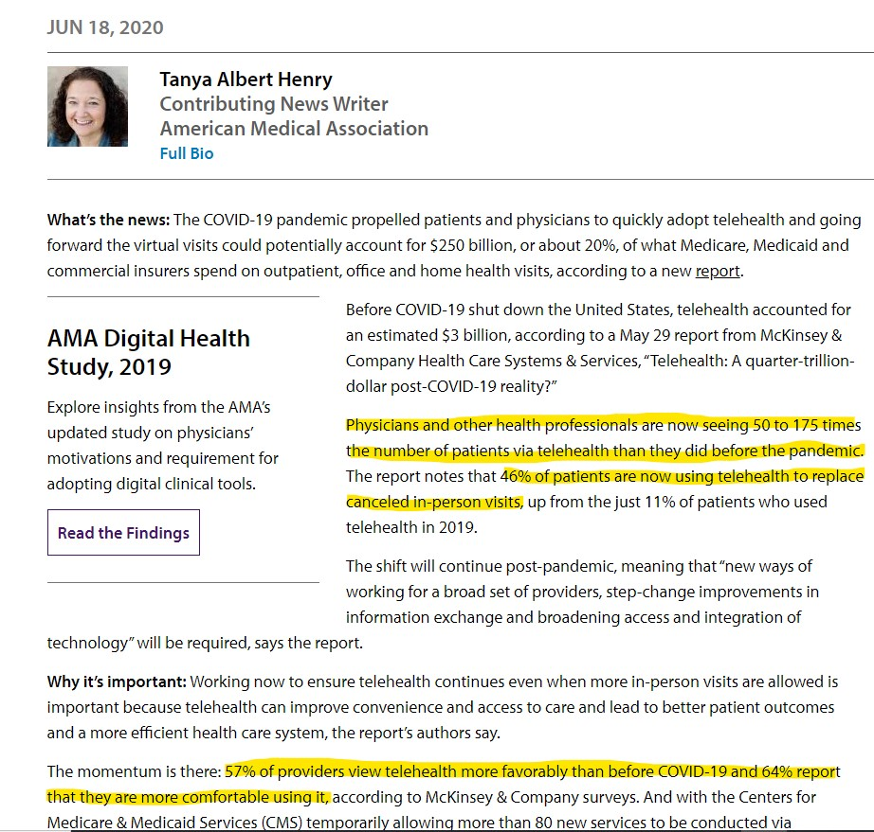
Next Steps American Medical Association Article
After COVID-19, $250 billion in care could shift to telehealth
By shifting this care to telehealth, the authors estimated that:
20% of all emergency room visits could be avoided.
24% of health care office visits and outpatient volume could be delivered virtually and an additional 9% delivered “near-virtually.”
35% of regular home health attendant services could be virtualized.
2% of all outpatient volume could be shifted to the home setting, with tech-enabled medical administration.

Slide 23
Telehealth in the News
Telemedicine Offers New Hope For Burnout Reduction During COVID-19
Telemedicine Tools Emerging in Medical School
Survey Shows Practitioners Learning Toward Telemedicine Future
No Medical Malpractice Found in Direct Telemedicine Cases
Future of health care after Covid-19: How telehealth is providing a catalyst for a change
Telecritical Care Expands Telehealth From the ICU to Where It’s Needed
FCC Boosts Rural Health Program Funding to Support Telehealth Expansion
Survey: COVID-19 Crisis Compels Dentists to Consider Telehealth
House to Debate Extending CARES Act Telehealth Coverage Indefinitely
CMS Moves to Make COVID-19 Home Health Telehealth Expansion Permanent
Lawmakers Want a Full Study of Telehealth During the COVID-19 Crisis

Slide 24
References
https://mhealthintelligence.com/topic/telehealth
http://telehealthtechnology.org/
https://www.azdhs.gov/preparedness/epidemiology-disease-control/infectious-disease-epidemiology/covid-19/dashboards/index.php
https://www.nrtrc.org/content/blog-post-files/Telehealth-Quick-Start-Guide.pdf
https://www.cdc.gov/coronavirus/2019-ncov/hcp/telehealth.html
https://www.cms.gov/newsroom/fact-sheets/medicare-telemedicine-health-care-provider-fact-sheet
https://www.matrc.org/wp-content/uploads/2020/04/Press-Ganey-Telemedicine_-1.pdf?9b3fb7&9b3fb7
https://southwesttrc.org/resources/forms
https://www.fsmb.org/advocacy/covid-19/
https://www.cchpca.org/telehealth-policy/telehealth-and-medicare
https://www.cms.gov/Outreach-and-Education/Medicare-Learning-Network-MLN/MLNProducts/Downloads/Telehealth-Services-Text-Only.pdf
https://www.cms.gov/files/document/covid-19-physicians-and-practitioners.pdf

